Slide 1


Slide 2
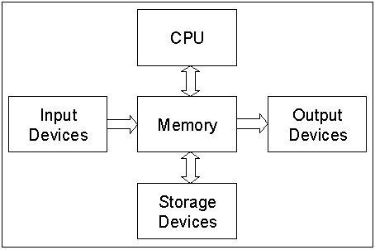
MEMORY BYTES

Slide 3

MEMORY

Slide 4

OUR
MEMORY
Internal
External

Slide 5

OUR INTERNAL MEMORY

Slide 6
Our internal memory is also divided into two!!!!
Permanent
Temporary

Slide 7


OUR EXTERNAL MEMORY

Slide 8


Do you know just like our memory , a computer also has a memory!!

Slide 9
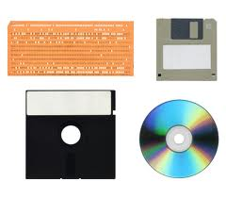
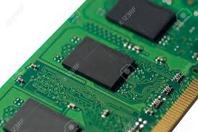
TYPES OF COMPUTER MEMORY
Primary or Internal
Memory
Secondary or External Memory

Slide 10
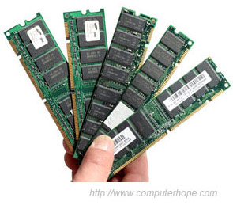
COMPUTER MEMORY
Random Access Memory
(RAM)
Volatile, temporary
PRIMARY
MEMORY
Read Only Memory (ROM), non-volatile, temporary

Slide 11
PRIMARY MEMORY
Primary memory is accessible directly by the processing unit.
The size of primary memory is less than that of secondary memory.
Primary memory is faster than secondary memory.

Slide 12
PRIMARY MEMORY: ROM
ROM ( Read Only Memory) is non-volatile (permanent). The contents in locations in ROM cannot be changed
It holds instructions that run the computer when it is
first turned on (BIOS). It stores some standard processing programs supplied by the manufacturers to operate the computer.
The ROM can only be read by the CPU but it cannot be changed

Slide 13
TYPES OF ROM
ROM: read-only memory
(Pre-programmed)
  PROM: programmable ROM
    Only written once
  EPROM: erasable PROM
    Use ultraviolet light to erase data
  EEPROM: electronically EPROM
    Can be erased using electronic impulses (higher voltages)

Slide 14
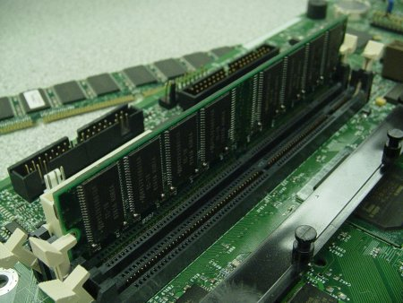
RANDOM ACCESS MEMORY (RAM)
RAM (Random Access Memory) is volatile (temporary). Programs and data can be written to and erased from RAM as needed.
As soon as the computer is switched off the contents of RAM is lost.

Slide 15
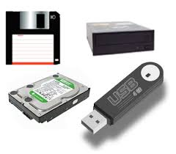
Secondary Memory
Storage devices hold data, even when the computer is turned off.
The hardware that writes data to or reads data from a storage medium is called a storage device.

Slide 16
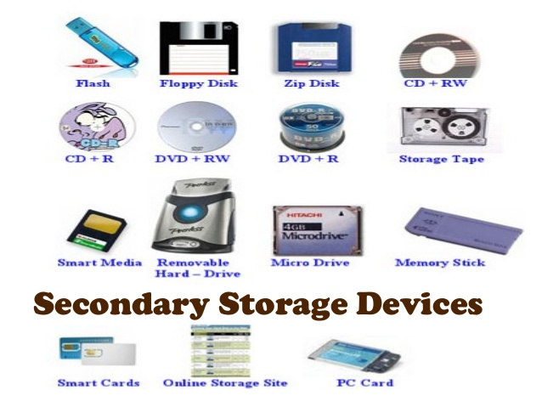

Slide 17
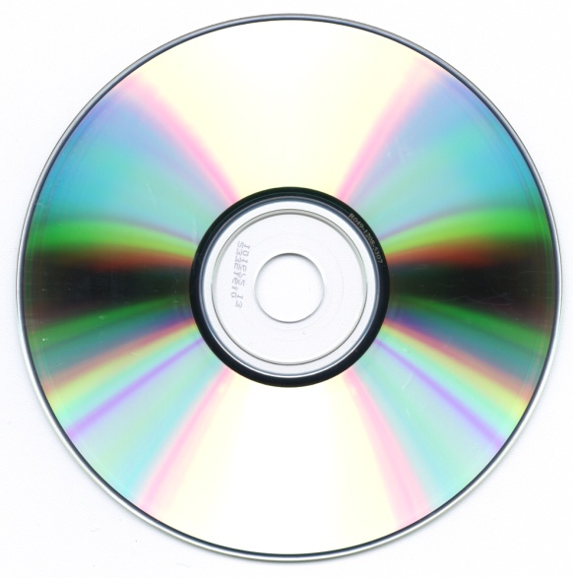
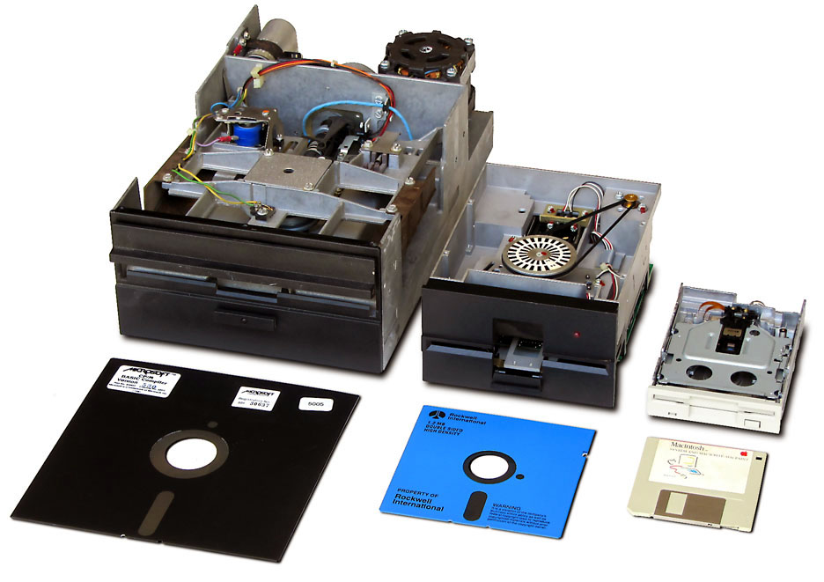
Secondary Memory:
Consists of :
Diskettes (floppy disks) (FDD)
Hard Disks (HD)
USB flash drive
Compact Disk Read-Only Memory (CD-ROM)
Digital Video Disk
CD-Recordable (CD-R)
CD-Rewritable (CD-RW)

Slide 18
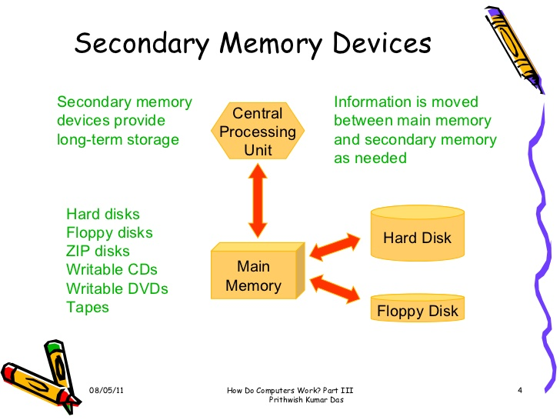

Slide 19
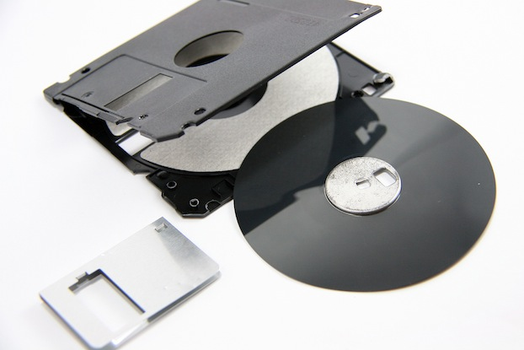
FLEXIBLE DISK

Slide 20
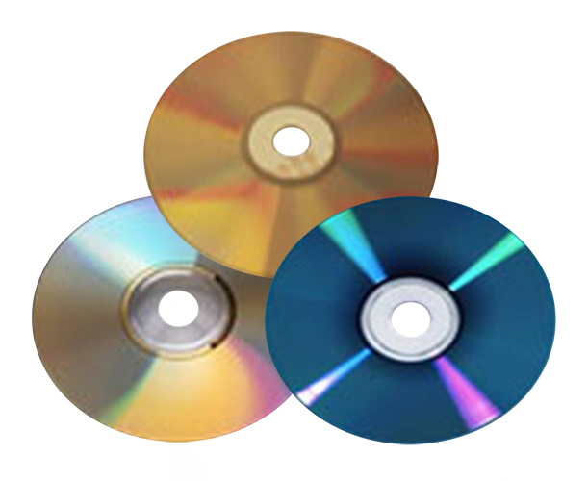

Slide 21
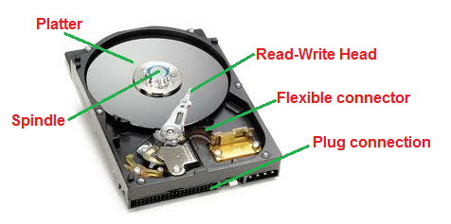
HARD DISK

